Slide 1
Projects Implemented Using Waterfall Model

Slide 2
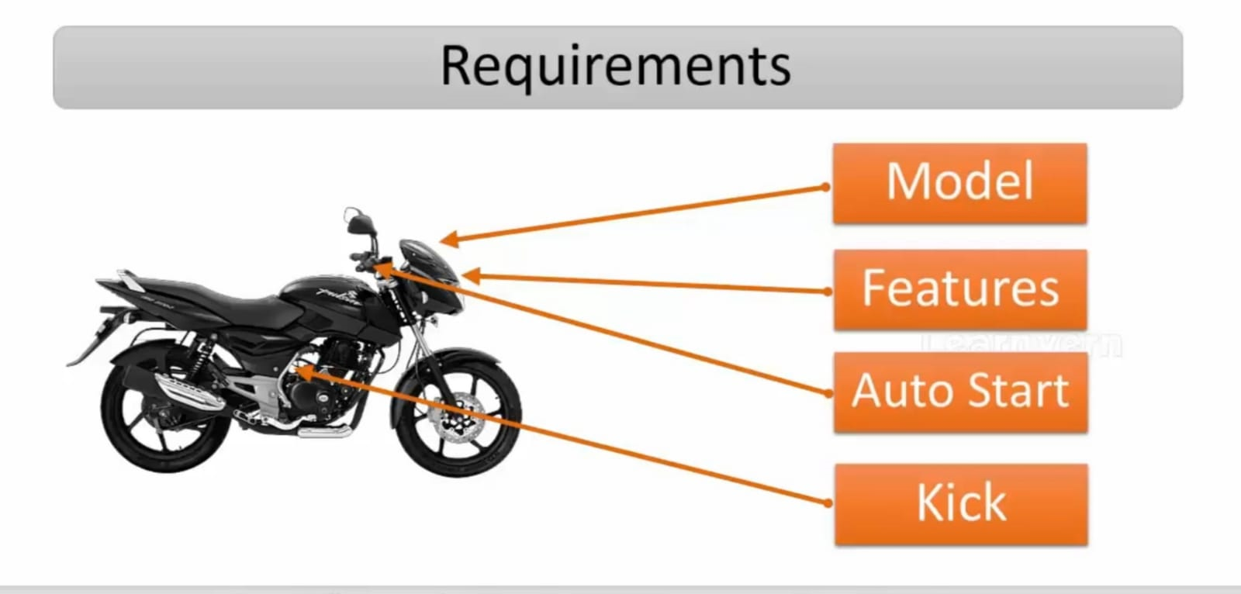
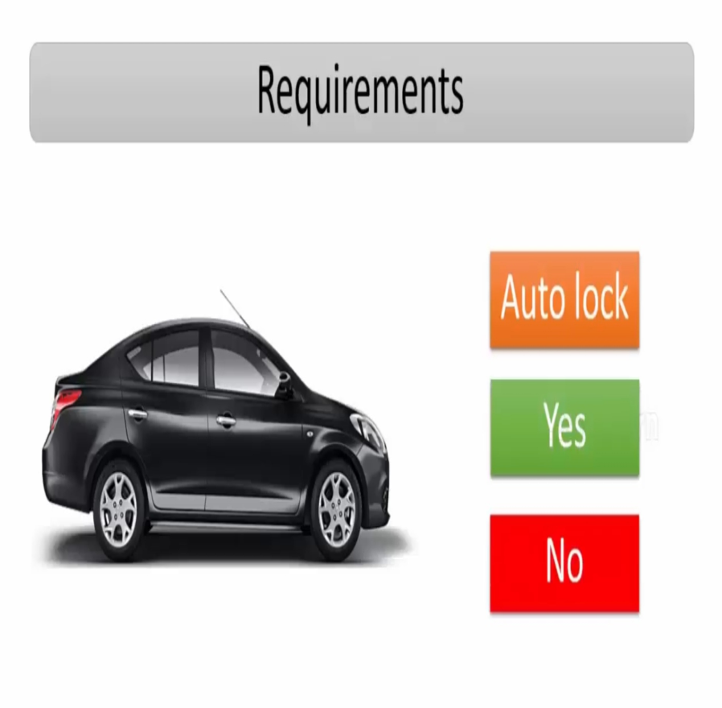
Automobiles

Slide 3
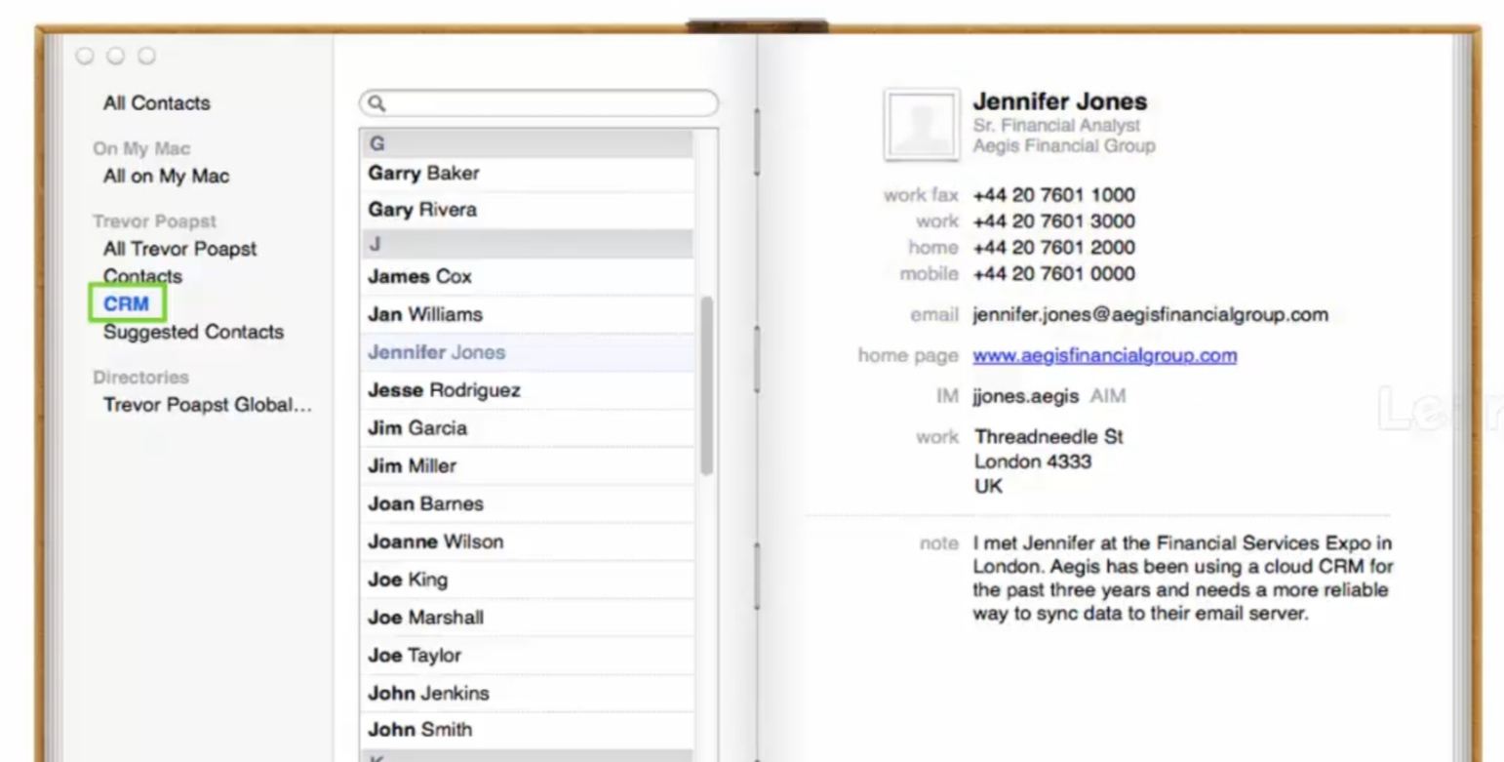
CRM tool (Customer Relationship Management tool)
HRM tool ( Human Resource Management tool)
Supply chain management

